Slide 1

MEDICAL BILLING 101
prepared by Medwave Billing & Credentialing

Slide 2

EVALUATION AND MANAGEMENT
Initial Patient Visit
  What information is being collected?
    Demographics
    Insurance
    Authorizations
    HIPAA compliance paperwork, Release of Information
http://medwave.io

Slide 3
PREPARING A CLEAN CLAIM
1) Demographics that must be collected
  Subscribers health insurance Policy Number (Box 1a.)
  Patients First and Last Name as presented on their health insurance card (Box 2 & 4)
  Patients Date of Birth and Sex (DOB) (Box 3)
  Patients Address ( Box 5 & 7 )
  Patients Relationship to the ensured ( Box 6 )
http://medwave.io

Slide 4
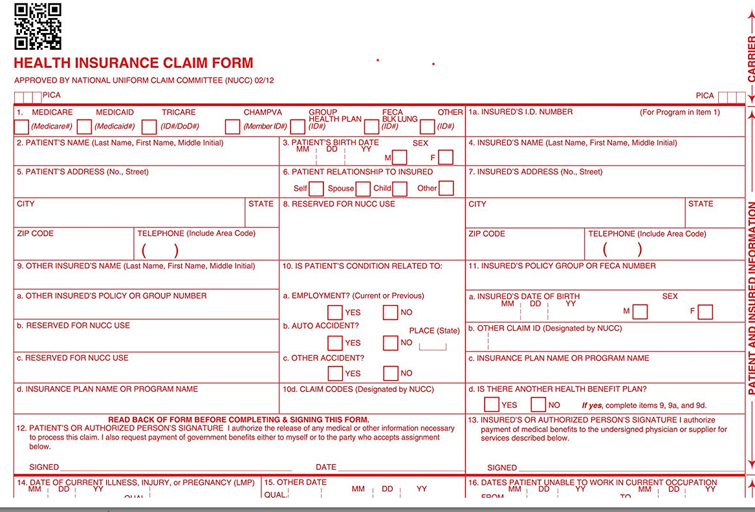
http://medwave.io

Slide 5
PATIENT ELIGIBILITY AND VERIFICATION
1) The patient's insurance can change at any point in time. It must be checked every time the patient comes in to the office.
How can we verify eligibility?
  Billing software can verify the patient's eligibility in real time (Athena)
  Using the insurance companies' online portals (Should be set up at time of credentialing)
  Calling the insurance company directly (Provider Phone is located on the back of card)
http://medwave.io

Slide 6
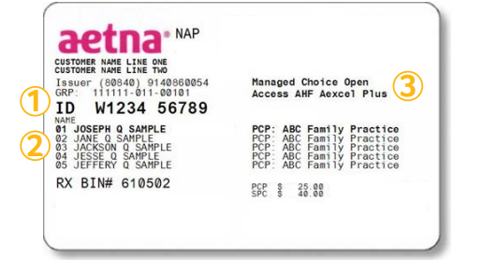
EXAMPLE INSURANCE CARDS
http://medwave.io

Slide 7
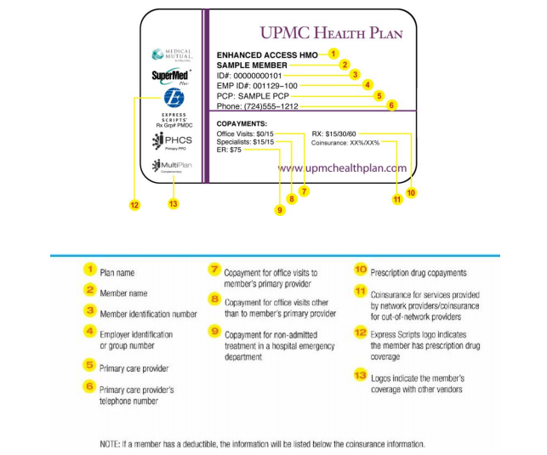
http://medwave.io

Slide 8
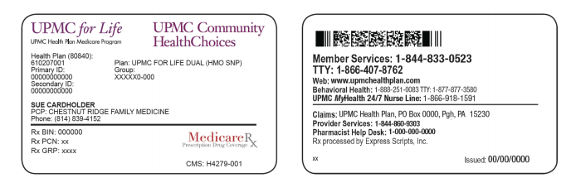
DUAL MEDICARE / MEDICAID PLAN
http://medwave.io

Slide 9
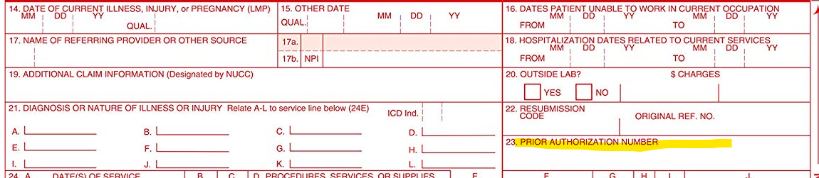
AUTHORIZATION FOR SERVICES
Our patient needed an authorization. Where does it go now?
  1) It should be recorded in the billing software’s Utilization Management tab.
  2) It is added to the claim for the date of service authorized. (Box 23)
  3) It should be part of the patients Electronic Health Record (EHR)
http://medwave.io

Slide 10
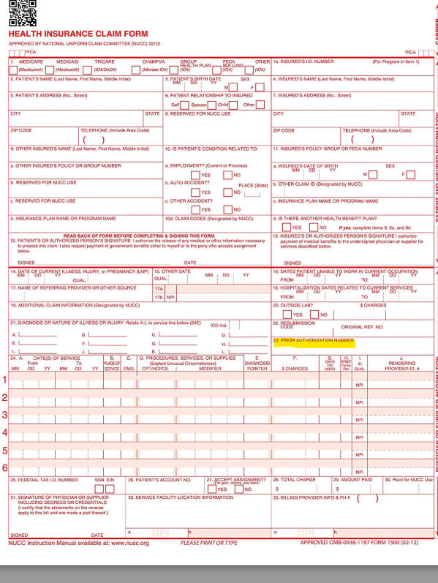
http://medwave.io

Slide 11
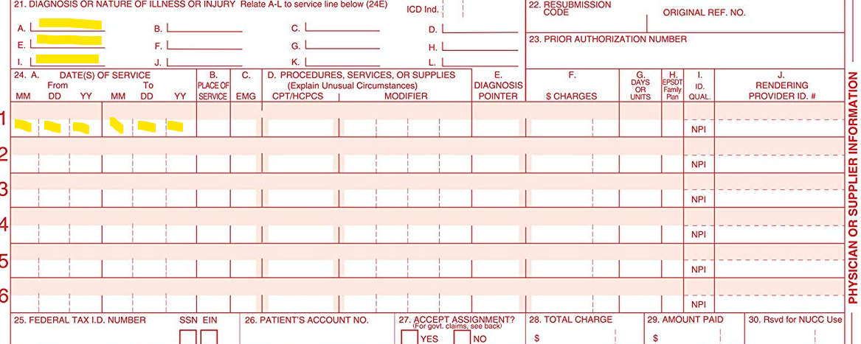
CHARGE ENTRY
1) Add the charge for the procedure done
2) Add the corresponding CPT code from the Coder
3) Add modifiers if needed
http://medwave.io

Slide 12
CREATING A UNIFORM FEE SCHEDULE
HOW TO IDENTIFY FEE SCHEDULES THAT ARE REASONABLE VS. ALLOWABLE FEE’S?
CHARGED AMOUNT
ACTUAL AMOUNT RECEIVED
The fee schedule that you use to bill with
Fee schedule for Self Pay Patients
What the practice is actually receiving back from the insurance company
http://medwave.io

Slide 13
CLAIM SUBMISSION
Claims can be submitted electronically, paper, payer portal
  The Payer ID is needed to submit claims electronically. They are usually located on the back of the patient’s insurance card. They can also be found on the payer’s provider manual.
    Payer ID’s may vary depending on the product (EX: Medicare vs Medicaid)
  Address for payers are located on the back of the patient’s card
    These addresses will vary depending on the product
    Workman’s Comp (WC) and Auto claims have designated addresses for claims
  Most Payer portals have Direct Data Entry (DDD) to enter a claim
http://medwave.io

Slide 14
POSTING ERA’S / EOB’S
Electronic Remittance advice ( ERA)
Explanation of benefits ( EOB )
  Both contain the information needed to post payment to the patients account
  Both contain the reason codes as to why the claim was paid or denied
http://medwave.io

Slide 15
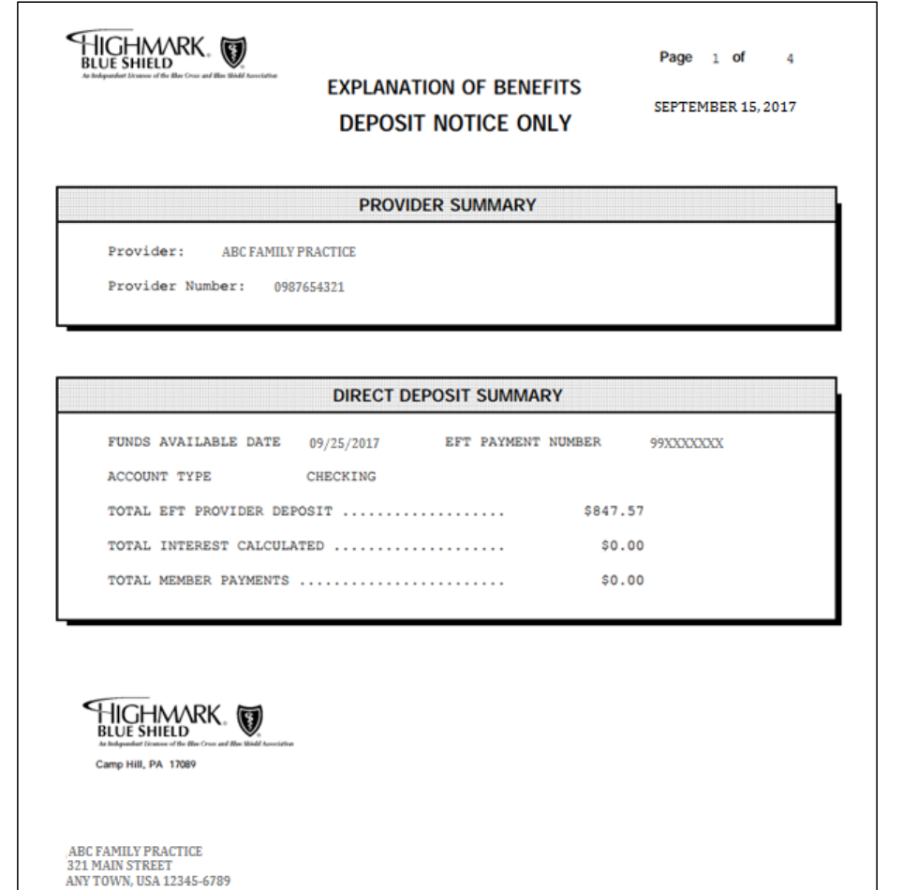
http://medwave.io

Slide 16
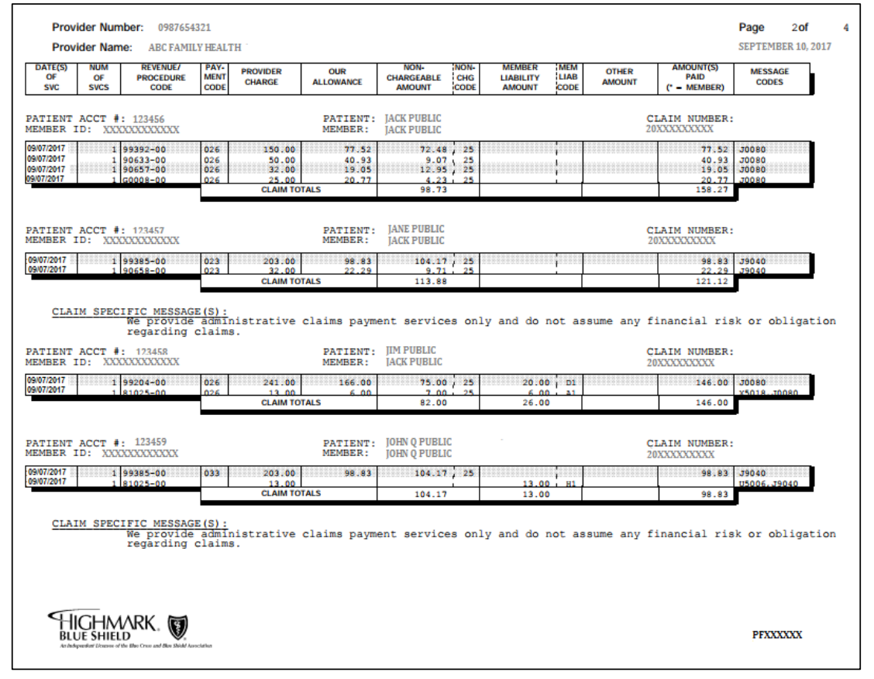

Slide 17
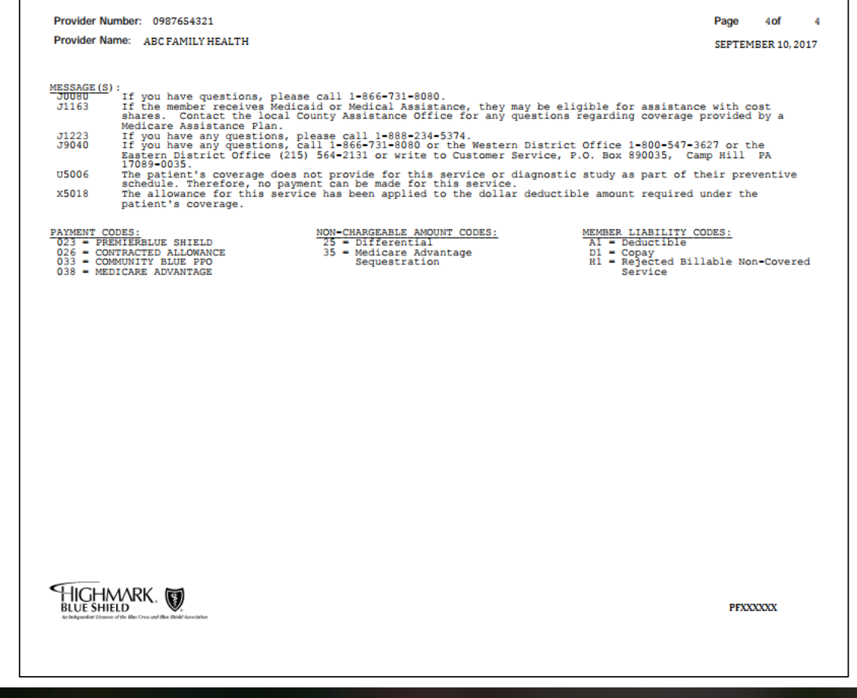

Slide 18
REJECTED OR DENIED CLAIMS
Review the EOB / ERA for Reason codes
Resubmit the claim
  Correct the claim in Athena
  Correct the claim in the payer portal
  If it is a clerical error then the billing staff should be advised for future reference.
http://medwave.io

Slide 19
CORRECTING A DENIED / REJECTED CLAIM
FIXING AN ERROR ON CLAIM
VOIDING THE CLAIM COMPLETELY
Resubmission Code 7 (BOX 22)
Original Claim Number (BOX 22)
  Alerts the payer that this is a replacement claim and not a duplicate
Resubmission Code 8 (BOX 22)
Original Claim Number (BOX 22)
  Alerts the payer that this claims is to be voided. A new claim could now be submitted.
http://medwave.io

Slide 20
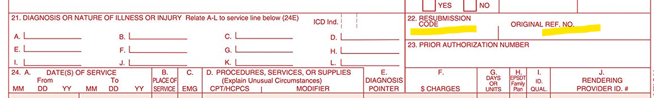
CORRECTING A DENIED / REJECTED CLAIM
http://medwave.io

Slide 21
WRITE OFF’S VS. CONTRACTUAL RATES
IS IT BETTER TO WRITE OFF AS CONTRACTUAL RATES? HOW TO AVOID WRITE OFFS?
CONTRACTUAL WRITE OFF
WRITE OFF FOR CHARGES
  Reimbursement rates are calculated when you sign your contract with the insurance company.
  Rates can change and can be periodically renegotiated
  These are the write offs you are not allowed to collect from the patient
These are the charges you bill out for the patient expecting to get back the contracted rate.
These are the charges you are allowed to collect
http://medwave.io

Slide 22
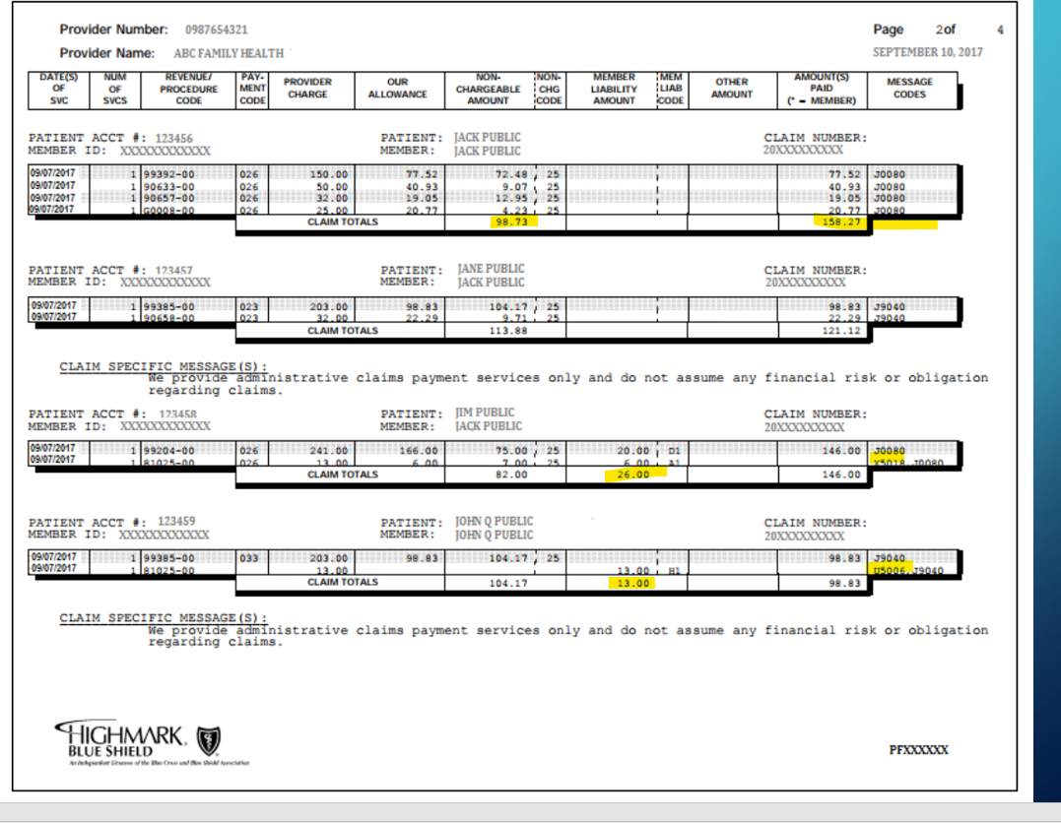
HOW TO DECIPHER CONTRACTUAL FROM AN ACTUAL WRITE OFF?
http://medwave.io

Slide 23
SECONDARY CLAIMS
PRIMARY CLAIM
SECONDARY CLAIM
Build you initial claim and submit
Post your primary payment
Convert your primary claim to reflect the secondary insurance
http://medwave.io

Slide 24
CYCLE OF A CLAIM
Check Eligibility and Benefits
Collect copay
Patient is seen by provider and visit is documented
Coder reviews patient's documentation and assigns CPT codes
Biller enters the charges, CPT codes, modifiers, DX codes
Claim is submitted electronically or on paper.
Claim is processed by payer
Electronic Remittance Advice (EOB) is received and posted to patient account
http://medwave.io

Slide 25
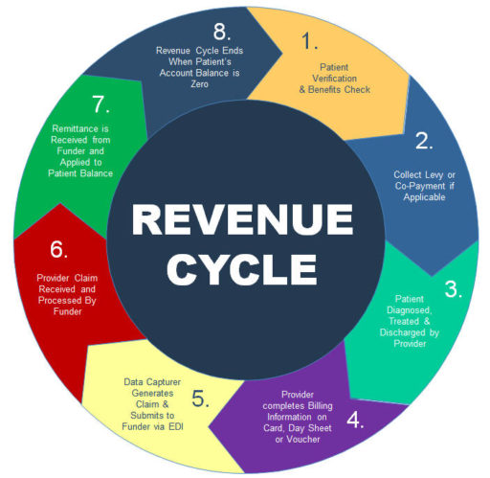
http://medwave.io

Slide 26
PROVIDER INFORMATION NEEDED ON CLAIM
Rendering Provider
  Individual NPI (Box 24J)
  Signature of Provider (Box 31)
Billing Provider
  Group Type II NPI (Box 32 & 33 a.)
  Address where Services were Rendered (Box 32)
  Address where Billing and Correspondence is sent (Box 33)
http://medwave.io

Slide 27
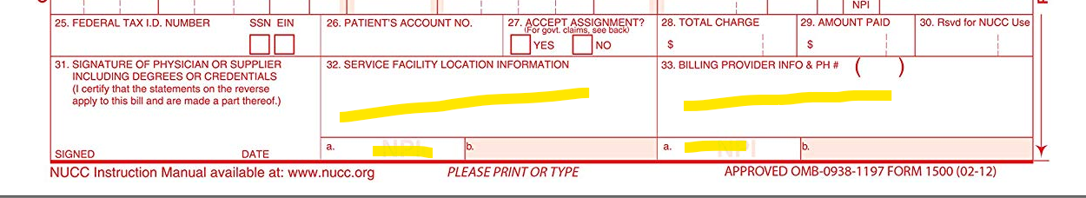
PROVIDER INFORMATION NEEDED ON CLAIM
http://medwave.io

Slide 28
Evaluation and Management:
Coding Evaluations
http://medwave.io

Slide 29
Overview
Evaluation and Management Services
Office and Outpatient Services
Consultations
Critical Care Services
Prolonged Services
Case Management Services
Care Plan Oversight Services
Preventive Medicine Services
Non Face-to-Face Services
Special E/M Services
Complex Chronic Care
Psychiatric Collaborative Care Management
Medicare Evaluation and Management
Medicaid Evaluation and Management
Rectal Exam Codes
Vaccine Codes
http://medwave.io

Slide 30
CPT 99201-99205 - Office and Outpatient Evaluation and Management
99201-99205
For NEW Office or Outpatient patients only
Only used once per start of care with Doctor
These codes can be used for Urgent Care Visits
http://medwave.io

Slide 31
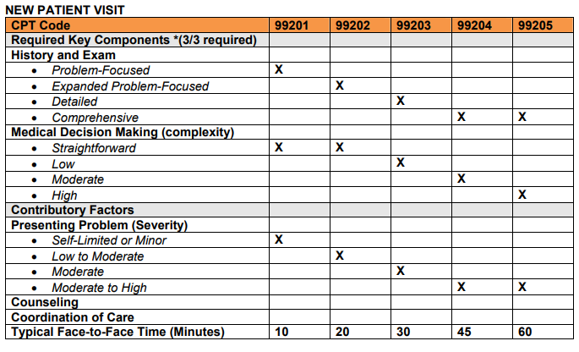
http://medwave.io

Slide 32
CPT 99211-99215 - Office and Outpatient Evaluation and Management
99211-99215
For ESTABLISHED Office or Outpatient patients only
Used for all subsequent visits within a 12-month year
These codes can be used for Urgent Care Visits
http://medwave.io

Slide 33
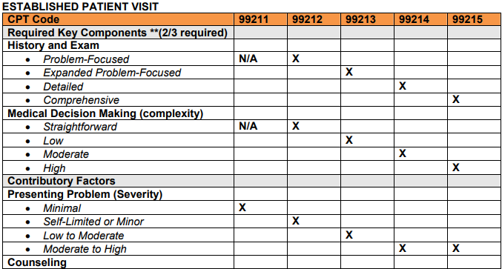
http://medwave.io

Slide 34
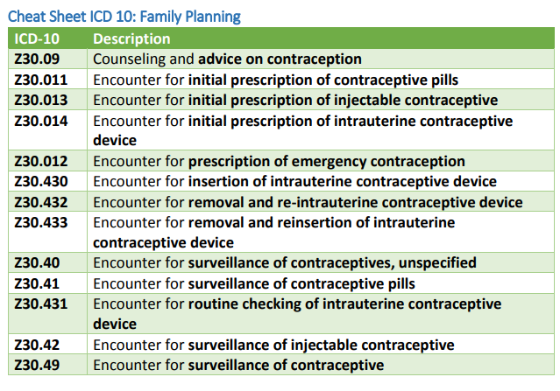
CODING SPECIALTY VISITS
Append the correct E/M code for the level of service
Apply the most descriptive DX code for the services being rendered
  EXAMPLE:
http://medwave.io

Slide 35
CPT 99241-99255 - Consultation Evaluation Codes
99241-99255
99241-99245- Office or Outpatient Consultation
99251-99255- Initial Inpatient Consultation Services
http://medwave.io

Slide 36
CPT 99291-99292 - Critical Care Services Evaluation Codes
99291-99292- for use with one or more vital organ failure (Life Threatening Condition)
99291- Critical Care Evaluation first 30-74 minutes
99292- Critica Care Evaluation, each addition 30 minutes you add one more unit.
http://medwave.io

Slide 37
CPT 99354-99416 - Prolonged Services Evaluation Codes
99354-99357
99354-99357- Prolonged Services with direct patient contact
99358-99359- Prolonged Services without patient contact
99360- Prolonged Standby Services
99415-99416- Prolonged Clinical Staff Services with Physician or other Qualified Healthcare Professional Supervision
http://medwave.io

Slide 38
When can you use Prolonged Evaluation Services?
Prolonged Service Codes are used in conjunction with another Evaluation and Management codes
  Used when the service goes above and beyond a TIMED E/M code for longer than 30 minutes. This is usually used when the coordination of care / counseling services exceed more than 50% of the visit
    This does not include the time with clinical staff, just the provider
  EXAMPLE: A patient is seen for 99213 office visit (E/M), but the patient was counseled for greater than 30 minutes, above the normal 15-29 minutes allotted for this level visit.
    The claim would need to be billed with CPT codes:
      99213
      99354- first 60 minutes
      99355- every subsequent 30 minutes
http://medwave.io

Slide 39
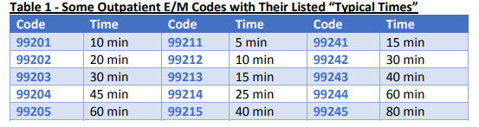
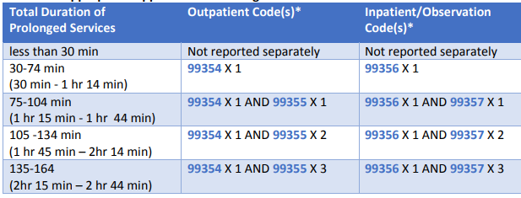
http://medwave.io

Slide 40
CPT 99366-99368 - Case Management Services Evaluation Codes
99366-99368
99366- Medical Team Conference with Direct Face-to-Face contact with patient or family ( 30 Min. Or More)
99367- Medical Team Conference by a Physician without Direct Face-to-Face contact with patient or family (30 Min. or More)
99368-Medical Team Conference Non-Physician without Direct Face-to-Face contact with patient or family (30 Min. or More)
http://medwave.io

Slide 41
CPT 99374-99380 - Care Plan Oversight Evaluation Codes
99374-99380
99374- 15-29 min.
99375- 30 min. Or more
99377- 15-29 Hospice Care
99378- 30 min. Or more Hospice Care
99379- 15-29 min. Nursing Facility Care
99380- 30 min. Or More Nursing Facility Care
G0181-G0182 (Medicare)
G0181 - Physician Supervision of Medicare Patient. (Home Health)
G0182 - Physician Supervision of Medicare Patient. (Hospice)
http://medwave.io

Slide 42
CPT 99381-99429 - Preventive Medicine Evaluation Codes
99381-99429
99381-99387- New Patient Preventive Services (Levels Based on Age)
99391-99397- Established Patient Preventive Services
99401-99412- Counseling Risk Factor Reduction and Behavior Change Intervention
99429- Other Preventive Services
http://medwave.io

Slide 43
Coding for Annual Wellness Visit
Visit Includes: Age and gender appropriate History, Exam, Counseling/Risk Factors/Intervention, Ordering of Labs / Procedures
New Patient- Initial wellness visit
  99381- Younger than 1 year
  99382- 1-4 years old
  99383- 5-11 years old
  99384- 12-17 years old
  99385- 18-39 Years old
  99386- 40-64 Years old
  99387- 65 years and older
Established Patient- Yearly Wellness visit
  99391- Younger than 1 year
  99392- 1-4 Years old
  99393- 5-11 Years old
  99394- 12-17 Years old
  99395- 18-39 Years old
  99396- 40-64 Years old
  99397- 65 Years and older
http://medwave.io

Slide 44
CPT 99401-99404- Preventive Counseling Visits
99401-99404- Counseling Risk Factor Reduction and Behavior Change Intervention
99401- Preventive Medicine Counseling 15 min.
99402- Preventive Medicine Counseling 30 min.
99403- Preventive Medicine Counseling 45 min.
99404- Preventive Medicine Counseling 60 min.
These codes are coded based on time and risk factor
http://medwave.io

Slide 45
DX CODES FOR PREVENTATIVE COUNSELING
Dietary Counseling
Exercise Counseling
Injury Prevention Counseling
HIV Counseling
STD Counseling
Contraception Counseling
Counseling concerning Lifestyle
Advice or Treatment for a non-attending 3rd party Counseling
Pediatric Pre-Birth Visit for an Expectant parent Counseling
Parental Concerns for a child Counseling
Marital and Partner Problem Counseling
Smoking Cessation Counseling
Substance use and abuse Counseling
Alcohol use and abuse Counseling
Z71.3
Z71.89
Z71.89
Z71.7
Z71.89
Z30.8, Z30.9
Z72.3, Z72.4, Z72.51, Z72.6, Z72.820, Z72.89, Z72.9
Z71.0
Z76.81
Z71.89
Z71.89
Z87.891
Z71.51
Z71.41
http://medwave.io

Slide 46
COUNSELING REQUIRING ADDITIONAL CPT CODES
SMOKING CESSATION
  99406- Intermediate Counseling
    3-10 Minutes
    25 Modifier on E/M Visit
    2 attempts a year, 4 sessions per attempt, 8 total sessions allowed per year
  99407- Intensive Counseling
    10 Minutes or greater
    25 Modifier on E/M visit
    2 attempts a year, 4 sessions per attempt, 8 total sessions allowed per year
DRUG USE AND ABUSE
  99408- Brief Intervention and screening
    15-30 Minutes
    25 Modifier on E/M visit
  99409- Brief Intervention and Screening
    30 Minutes or more
    25 Modifier on E/M visit
http://medwave.io

Slide 47
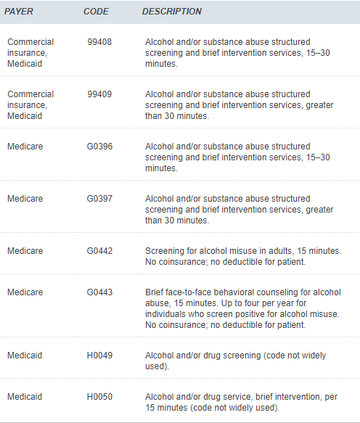
http://medwave.io

Slide 48
CPT 99441-99452 - Non Face-to-Face Services Evaluation Codes
99441-99452
99441-99443- Non-Face-to-Face Telephone Services
99444-99444- Non-Face-to-Face On-Line Medical Evaluation
99446-99452- Interprofessional Telephone/Internet/ Electronic Health Record Consultations
http://medwave.io

Slide 49
CPT 99450-99457 - Special Evaluation/Management Services Codes
99452-99457
99450-99454- Basic Life and or Disability Evaluation
99455-99457- Work Related Disability Evaluation
http://medwave.io

Slide 50
CPT 99483-99484 - Complex Chronic Care Services Codes
99483-99484
99483- Comprehensive Evaluation for patient with Cognitive Impairment
99484- BHI Care Management
http://medwave.io

Slide 51
CPT 99492-99494 - Psychiatric Collaborative Care Management
99492-99494
99492- Initial Psychiatric Collaborative Care Management (First 70 Min. in first month)
99493-Subsequent Psychiatric Collaborative Care Management (First 60 Min. in subsequent month)
99494-Initial or Subsequent Psychiatric Collaborative Care Management (Each Additional 30 Min.)
http://medwave.io

Slide 52
Medicare Evaluation and Management Codes
Welcome to Medicare Visit
G0402: Medicare Preventive visit (Welcome to Medicare)
Frequency: One time in first 12 months, upon enrolling in Medicare
DX: Z00.00, Z00.01
Subsequent Yearly Visits
G0438- Yearly Wellness Exam, 12 months after Welcome Visit
G0439- Subsequent Exams 12 mo. after G0438
http://medwave.io

Slide 53
Medicaid Evaluation and Management Codes
Yearly Exams- 99385-99397
99385-99387- New Patient Yearly Exam (Only Used Once)
99395-99397- Established Patient Yearly Exam (Every 12 Months)
DX: Z00.00, Z00.01
99201-99205
New Patient Exam(Only Used Once)
Not Considered a Yearly Exam
99211-99215
Established Patient Subsequent Exam
http://medwave.io

Slide 54
RECTAL EXAM CODES- Women
S0601- Screening Protoscopy
S0610- Annual Gynecological Exam- New Patient
S0612- Annual Gynecological Exam- Established Patient
  *When these codes are used as a screening per the patients benefits then the price is included in the E/M service. If not, it can be reimbursed separately by appending Modifier “25” to the E/M service.
http://medwave.io

Slide 55
RECTAL EXAM CODES- Men
S0605- Digital Rectal Exam, Male, Annual
84153- Prostate Cancer Screening; (PSA) Prostate Specific Antigen Test (Test ordered with signs and symptoms)
G0102- Prostate Cancer Screening (Medicare Code)
G0103- Prostate Cancer Screening; (PSA) Prostate Specific Antigen Test (Medicare Code)
  DX code Z12.5- Encounter for Screening for Malignant Neoplasm of Prostate
  DX code R97.20- Rectal Exam Screening
  When these codes are used as a screening per the patients benefits then the price is included in the E/M service. If not, it can be reimbursed separately by appending Modifier “25” to the E/M service.
http://medwave.io

Slide 56
VACCINES for Out of Network or Non- PC Provider
1) Most insurance companies will want the patient to be seen by an
IN-NETWORK provider. (Varies by plan, there are some exceptions)
2) You do NOT have to be the PCP to administer Vaccines.
  Preventative Vaccines- To ensure they are paid; they should be billed with a DX code that says it is a primary reason for the visit.
http://medwave.io

Slide 57
Evaluation and Management:
Basic Components
http://medwave.io

Slide 58
Medical Decision Making
Straightforward
Low Complexity
Moderate Complexity
High Complexity
How do I know what level to use?
Number of DX and Management Options
Amount and Complexity of Data
Risk
http://medwave.io

Slide 59
Straightforward
Patient History: Problem Focused
10-20 Min.
Moderate Complexity
Patient History: Comprehensive
45 Min.
Yearly Visit: Once every 12 months
1-2 DX
2-3 DX
3-4 DX
5 + DX
Z00.00 Z00.01
Low Complexity
Patient History: Expanded Problem
30 Min.
High Complexity
Patient History: Comprehensive
60 Min.
http://medwave.io

Slide 60
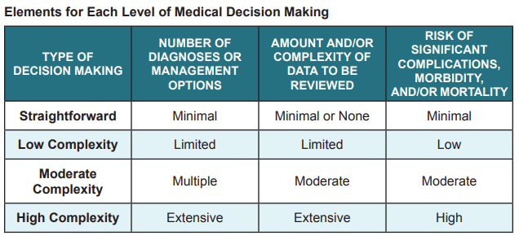
http://medwave.io

Slide 61
Patient History
The Elements Required for Each Type of History:
  CC-Chief Complaint,
  HPI-History of Present Illness
  ROS-Review of Systems
  PFSH- Pertinant, Past, Family, Social History
To qualify for a given type of history, all four elements indicated in the row must be met. (Note that as the type of history becomes more intensive, the elements required to perform that type of history also increase in intensity.)
http://medwave.io

Slide 62
EXAMPLE:
A problem focused history requires:
    documentation of the chief complaint (CC)
    a brief history of present illness (HPI),
2. A detailed history requires:
the documentation of a CC,
an extended HPI,
an extended review of systems (ROS),
past, family, and/or social history (PFSH).
http://medwave.io

Slide 63
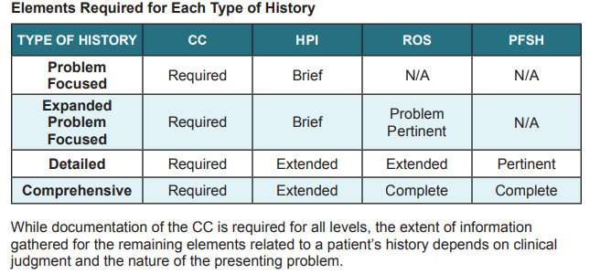
http://medwave.io

Slide 64
The Assessment of Risk
Presenting problem(s)
Diagnostic procedure(s)
Possible management options
The level of risk of significant complications, morbidity, and/or mortality can be:
Minimal
Low
Moderate
High
http://medwave.io

Slide 65
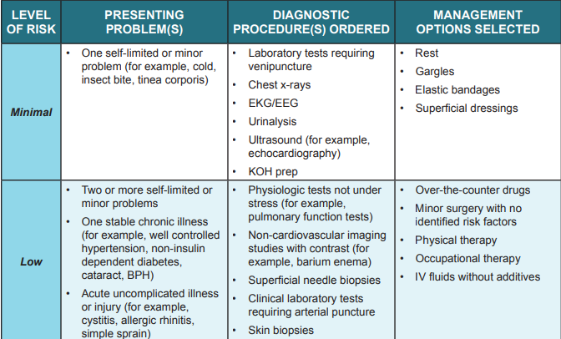
http://medwave.io

Slide 66
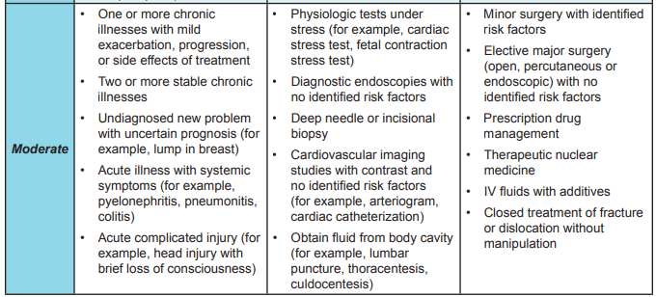
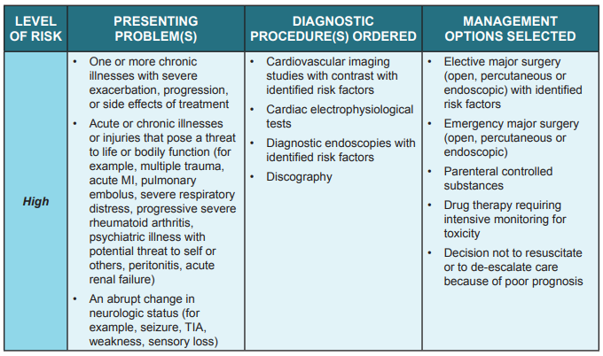
http://medwave.io

Slide 67
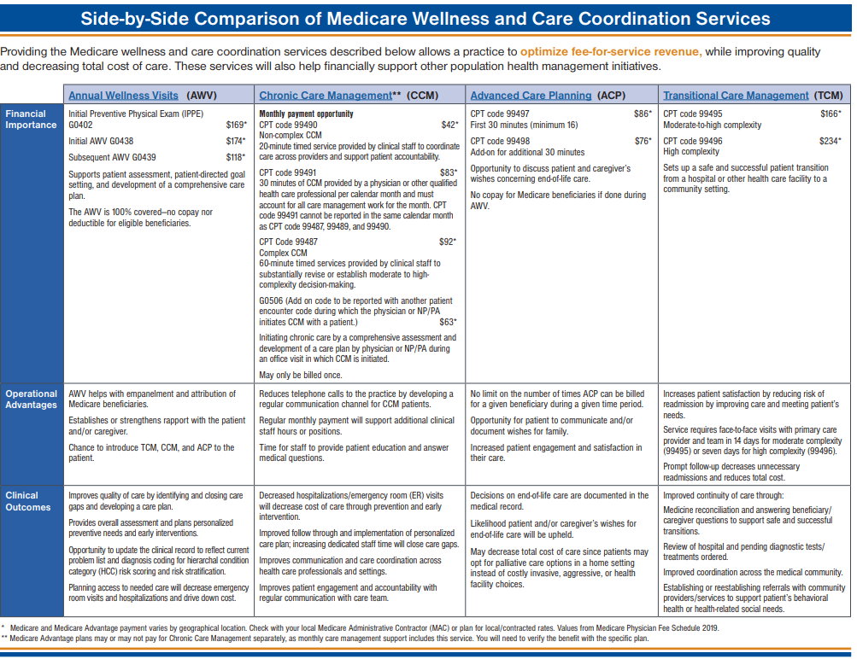
http://medwave.io

